Slide 1
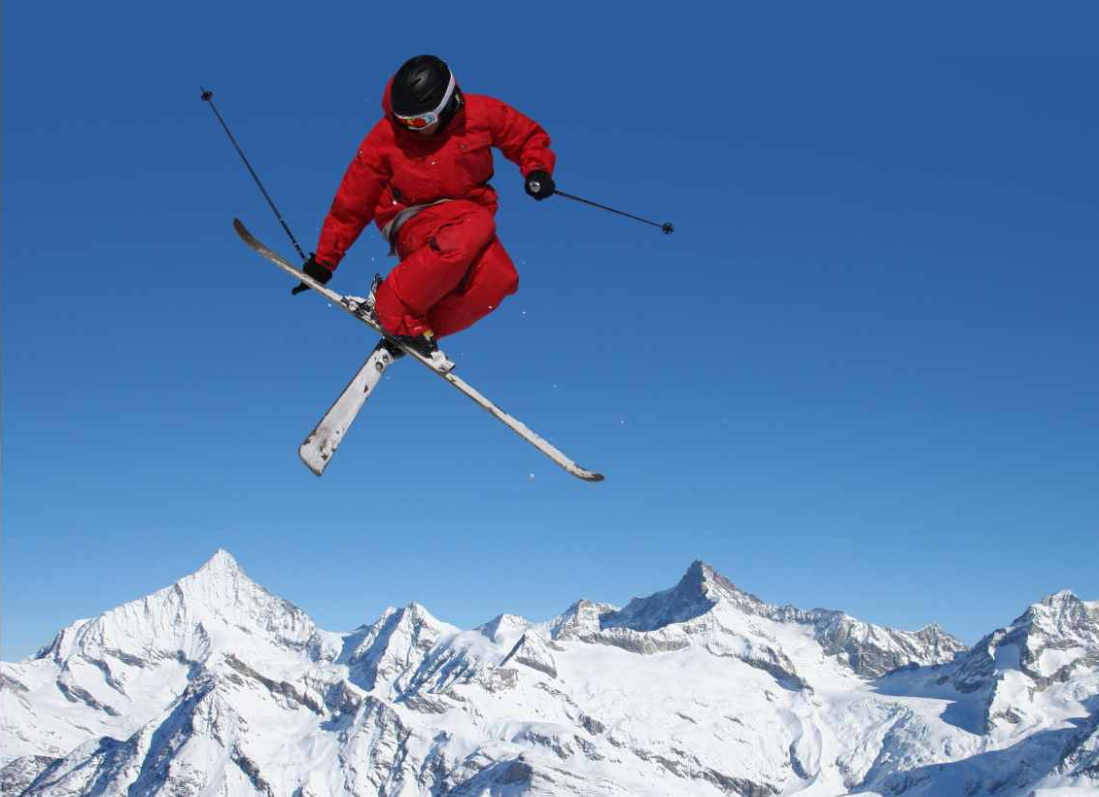
IST 687 Final Project
Alrighty YEAH! SKIING
Alrighty YEAH! SKIING
Alrighty YEAH! SKIING
A database model for a ski resort to track rentals and lift tickets.
Sean Deery, Christian Dobish, Blake Tindol, Leonard Lasek

Slide 2
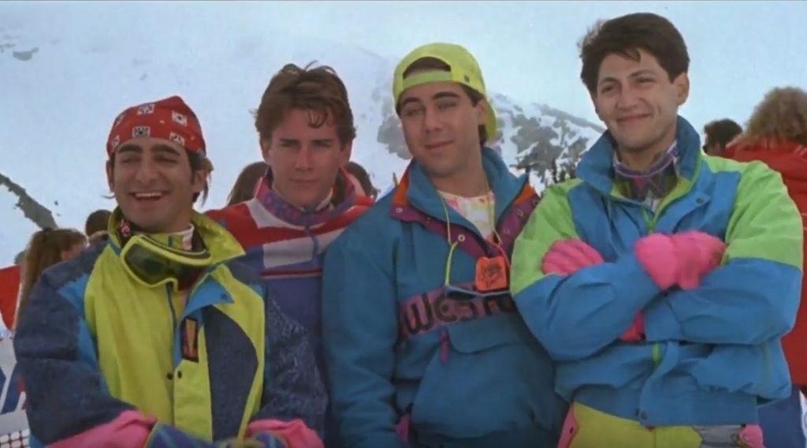
Team Members
Leonard Lasek
Blake Tindol
Sean Deery
Christian
Dobish

Slide 3
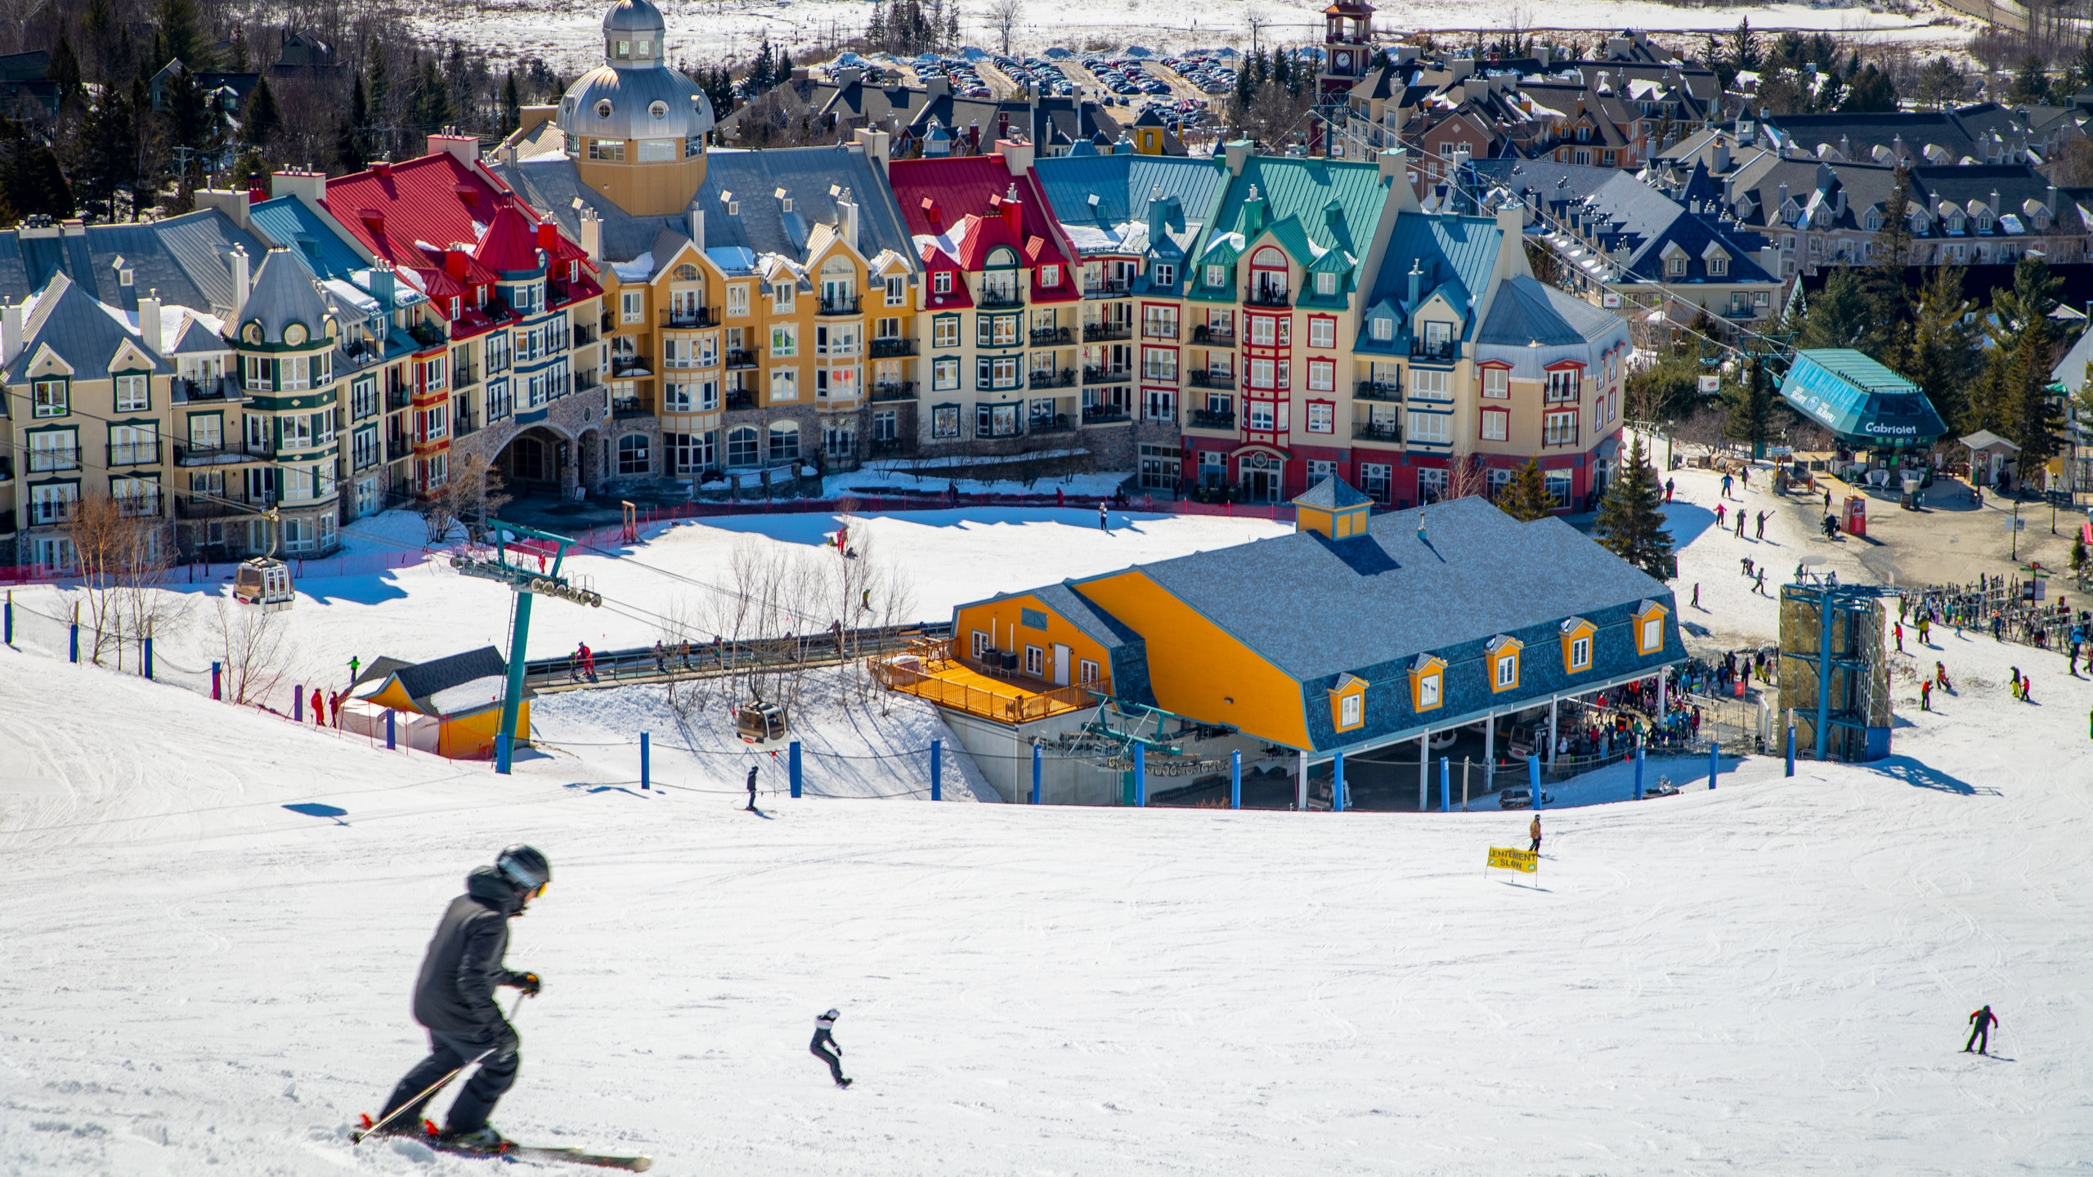
Project Guidelines
Brief description of the project and its objectives:

Slide 4
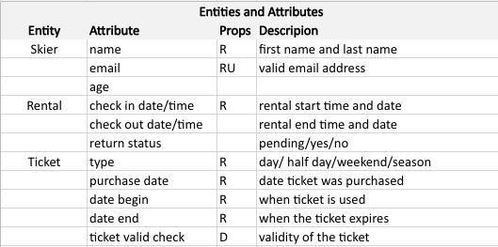
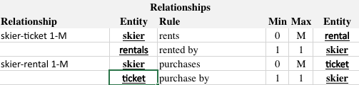
Data Analysis
Data analysis of the facts, entities, attributes, and relationships in the data model.
Entities and Attributes
Relationships

Slide 5
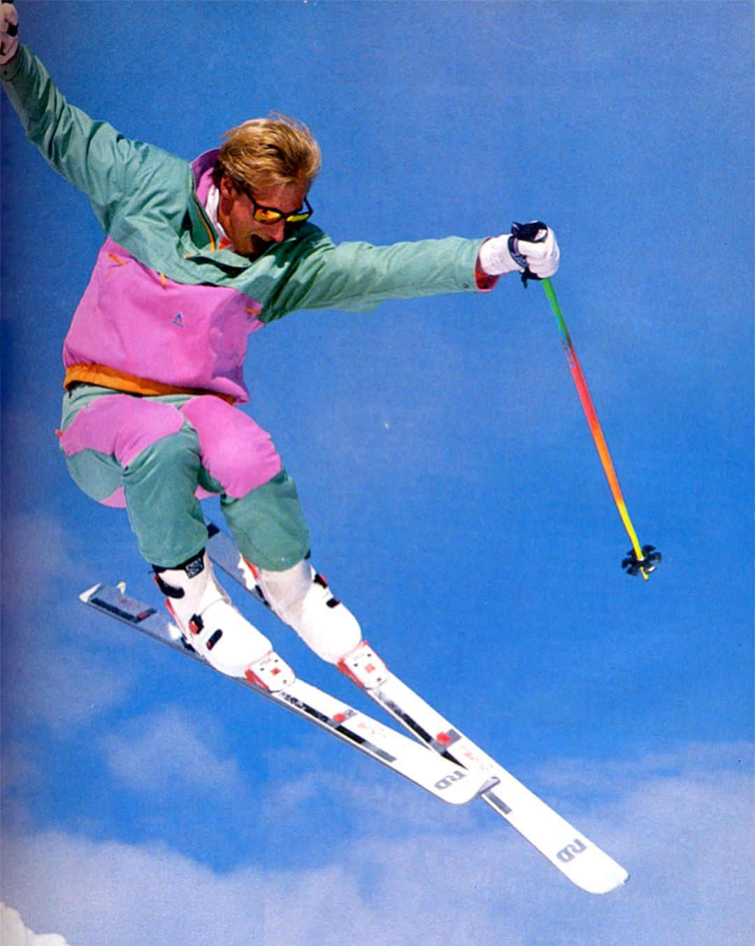
Data Modeling
Mapping Conceptual to Logical

Slide 6
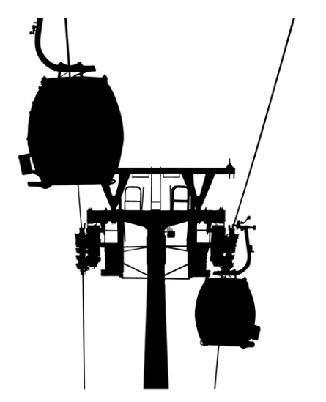
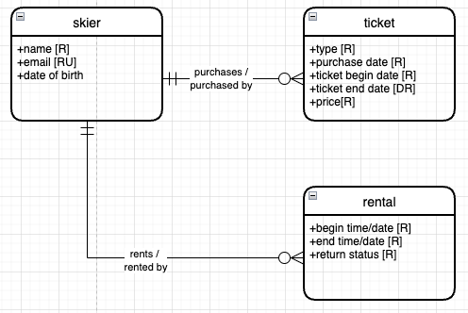
Conceptual Model:
We chose to limit the number of entities in our conceptual model. As the in-class example showed a limited number of entities was sufficient to create a through and in-depth logical model.

Slide 7
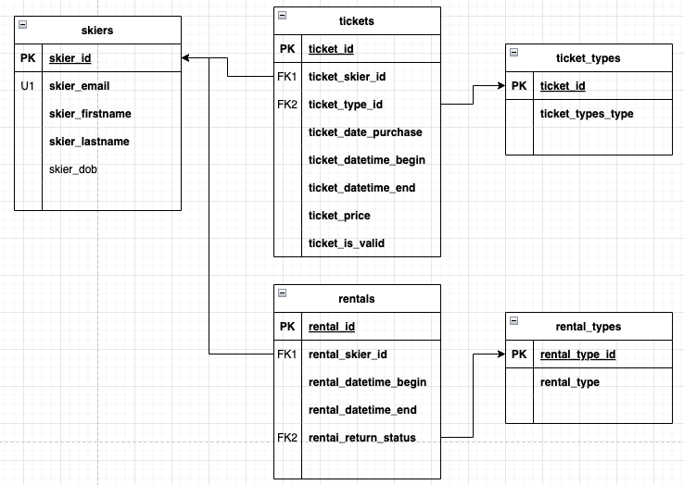

Logical Model:
Implementation of our conceptual data model. The framework we will use to build our database.

Slide 8

External Data Model and Data Logic:
Skier
Buy a lift ticket for a specific date. Lift tickets can be half-day, full-day, week, or year. One skier can buy multiple tickets (e.g., parent buys tickets for kids). If the skier has already purchased a ticket for the same day, they will receive a warning that they already have tickets before they can buy more.
Buy a rental for a ticket. A rental includes all the equipment (skis, boots, poles, helmet, etc.) for 1 skier.
Main Office Attendant
Sell a ticket and a rental to a skier. If the skier has already purchased a ticket for that day, the attendant will let them know how many tickets they have already bought before they purchase more.
Distribute physical tickets, which makes the ticket valid for the lift gates.
Rental Shop Attendant
Distribute a rental and mark as taken out.
Collect rental equipment and mark as returned.
Lift Gates
Check if a ticket is valid before opening gate.

Slide 9
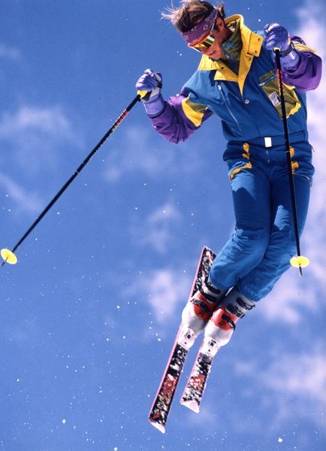
Application
Diagrams Of User Screens

Slide 10
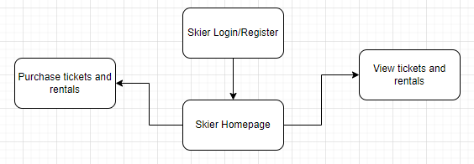
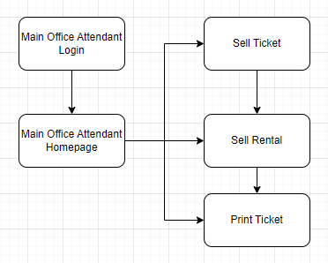
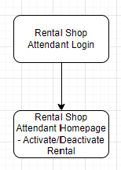
Diagram of each screen that will be used in the application:
Skier View
Main Office View
Rental Shop View

Slide 11
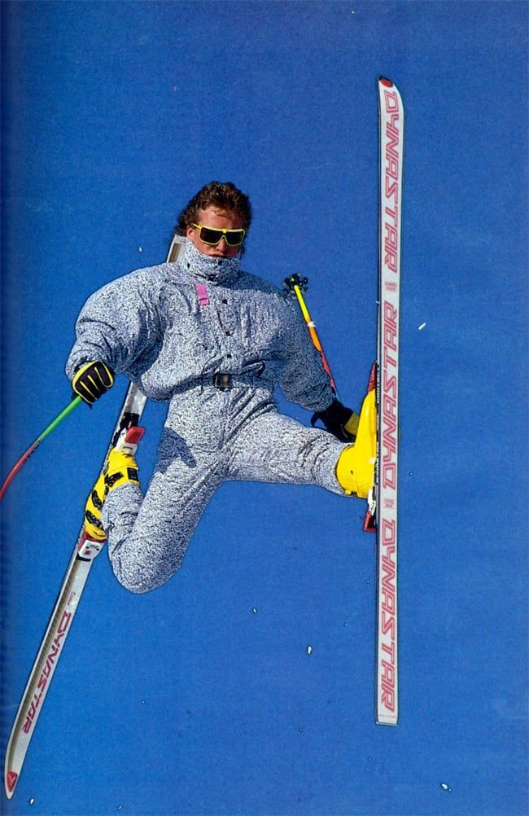
Internal Model
SQL Up/Down Scripts

Slide 12
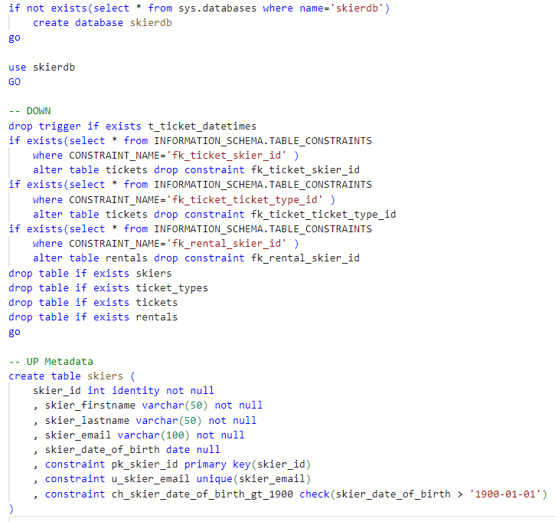
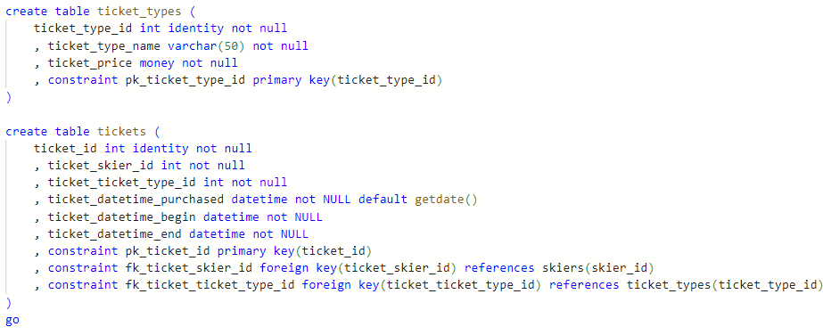
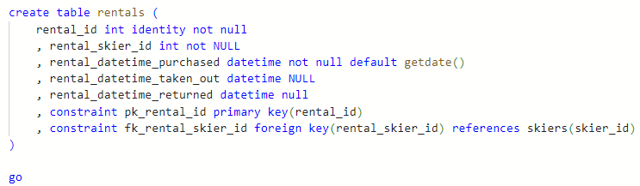
Internal Model

Slide 13
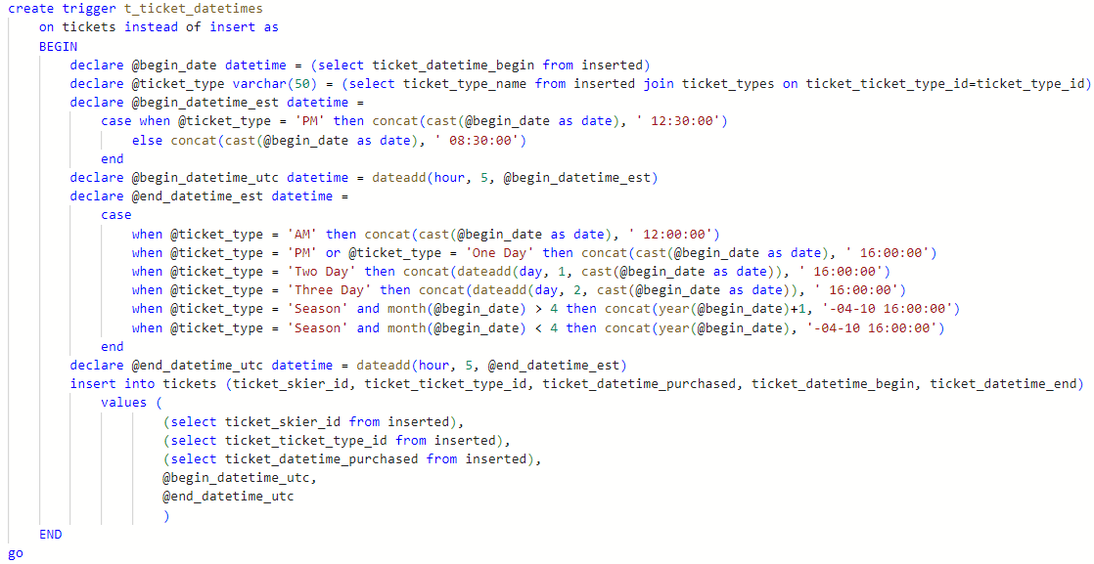
Internal Model

Slide 14
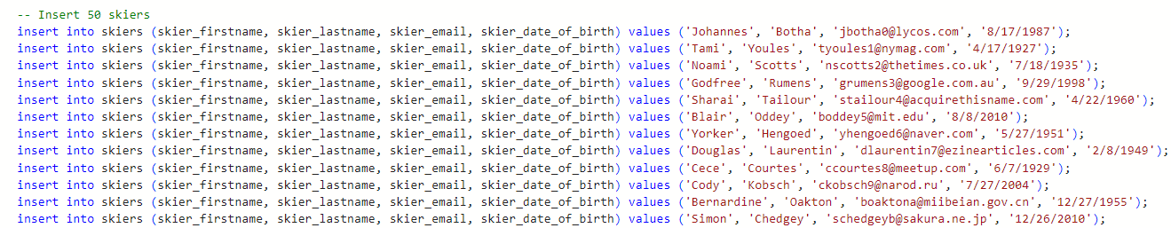
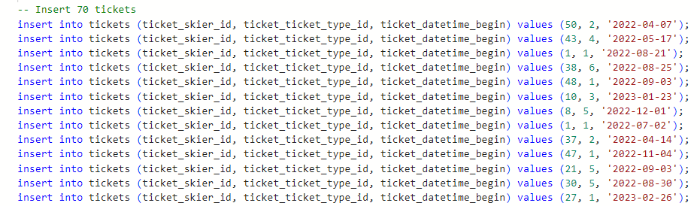
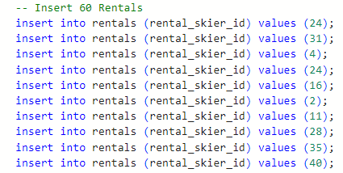
Mockaroo Data

Slide 15
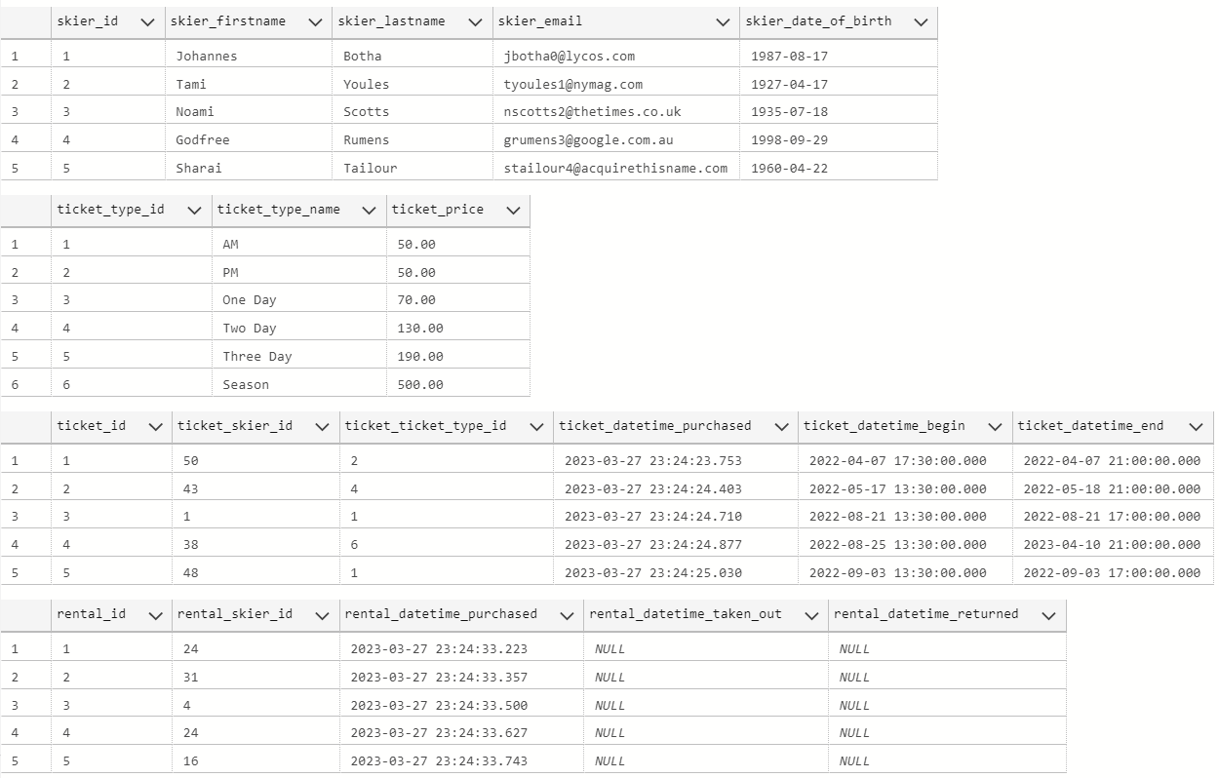
Verify Internal Model

Slide 16
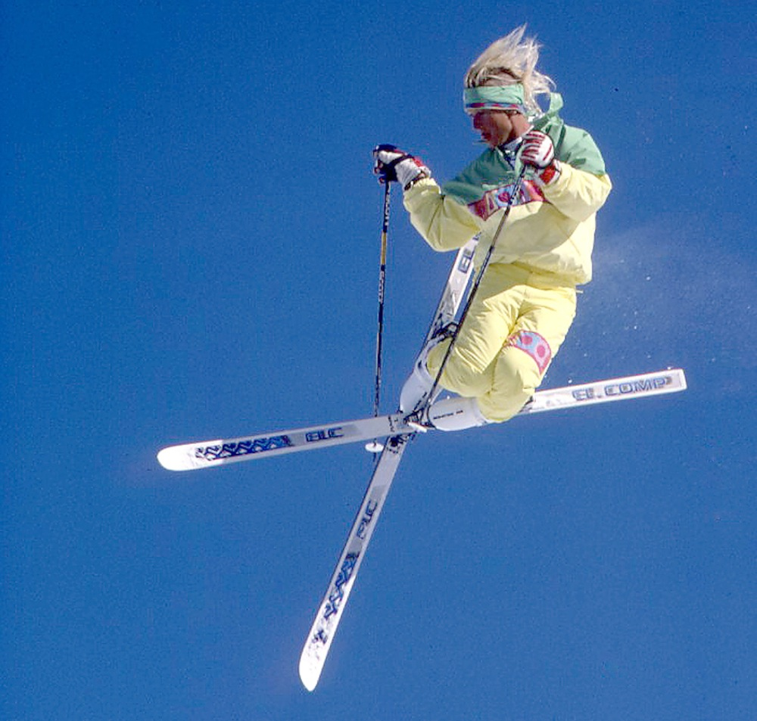
External Model
SQL Up/Down Scripts

Slide 17
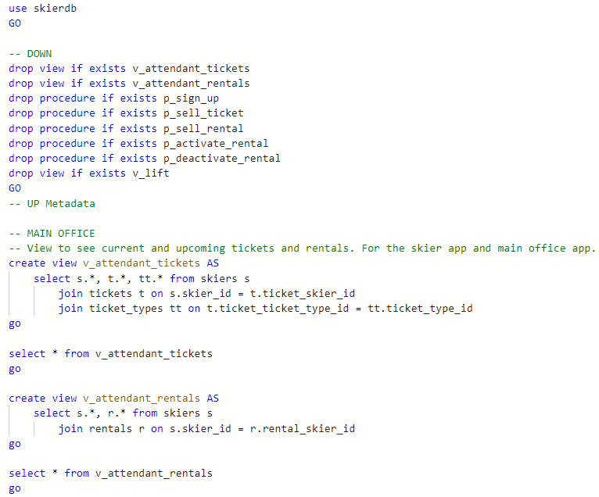
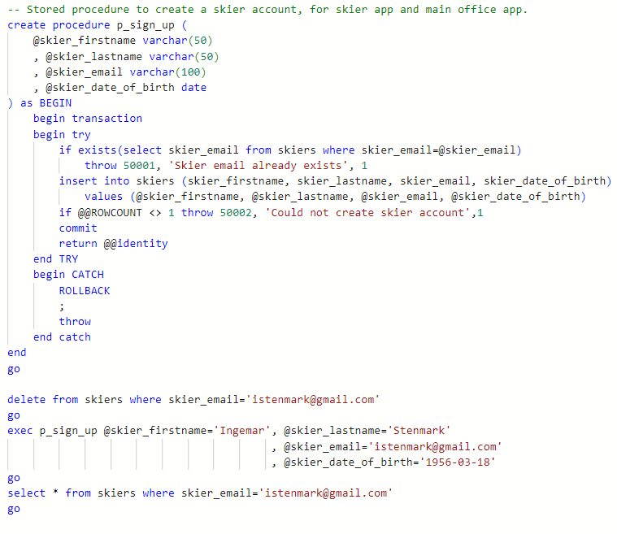
External Model

Slide 18
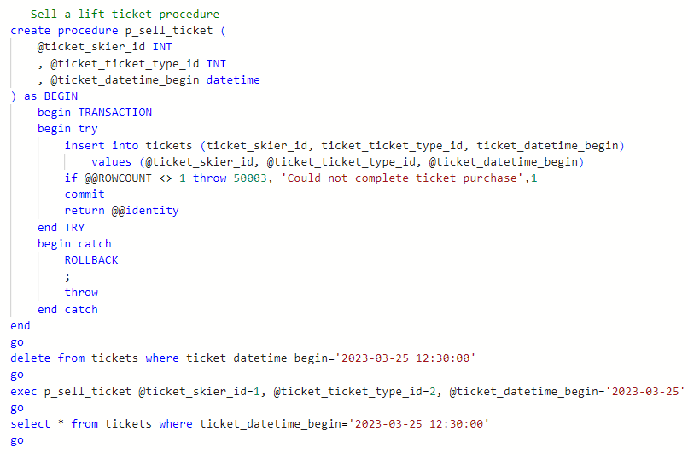
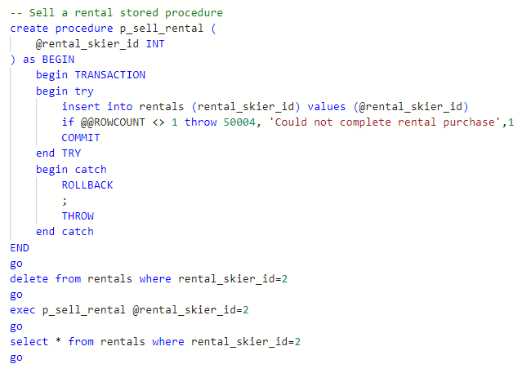
External Model

Slide 19
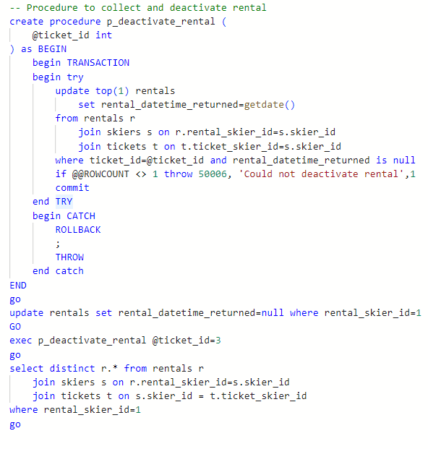
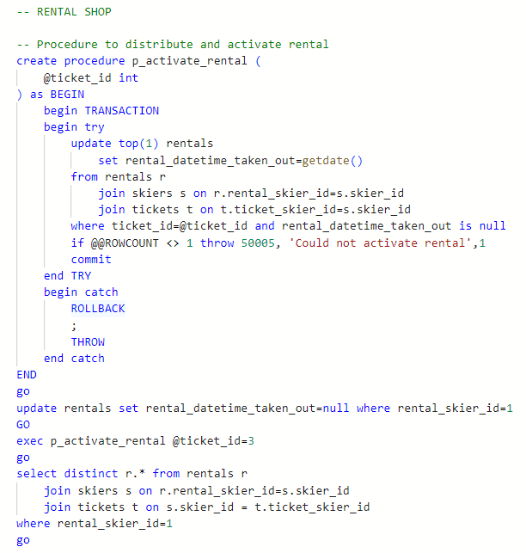
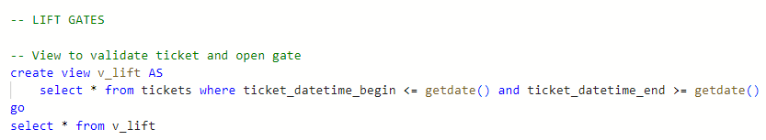
External Model

Slide 20
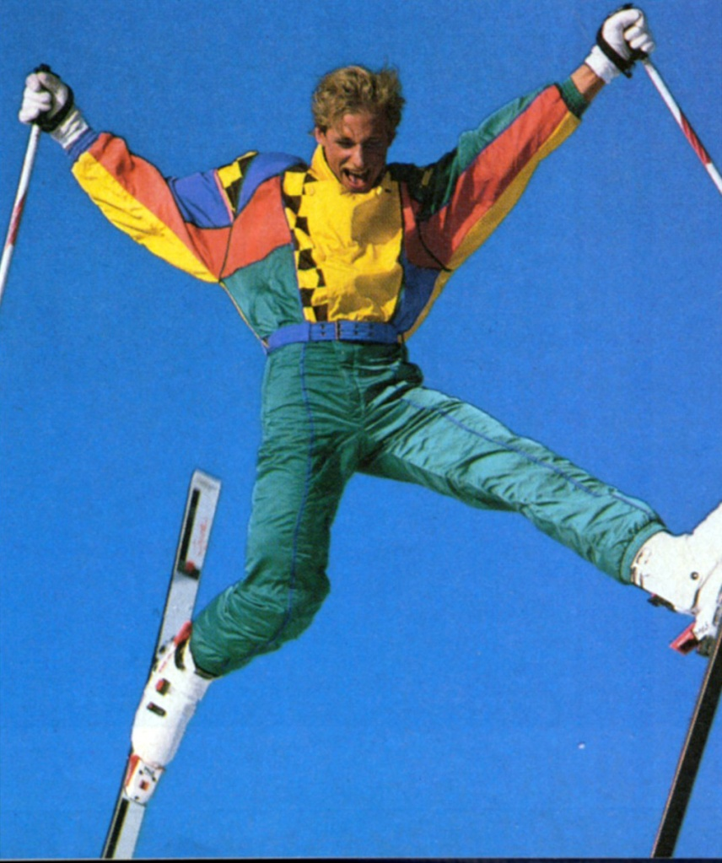
Implementation
Example Interaction & Application

Slide 21
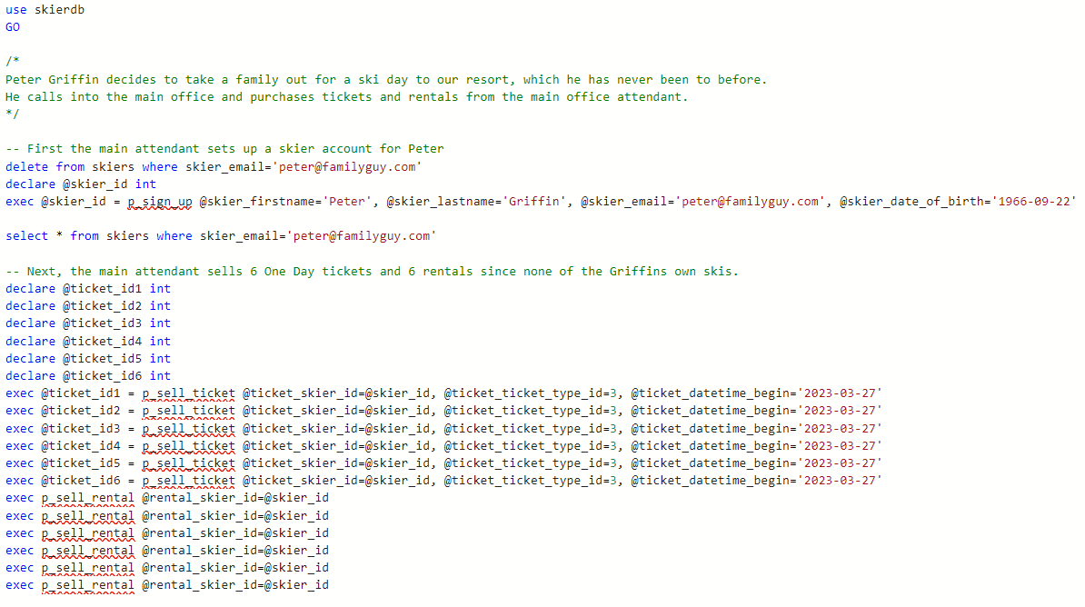
Implementation

Slide 22
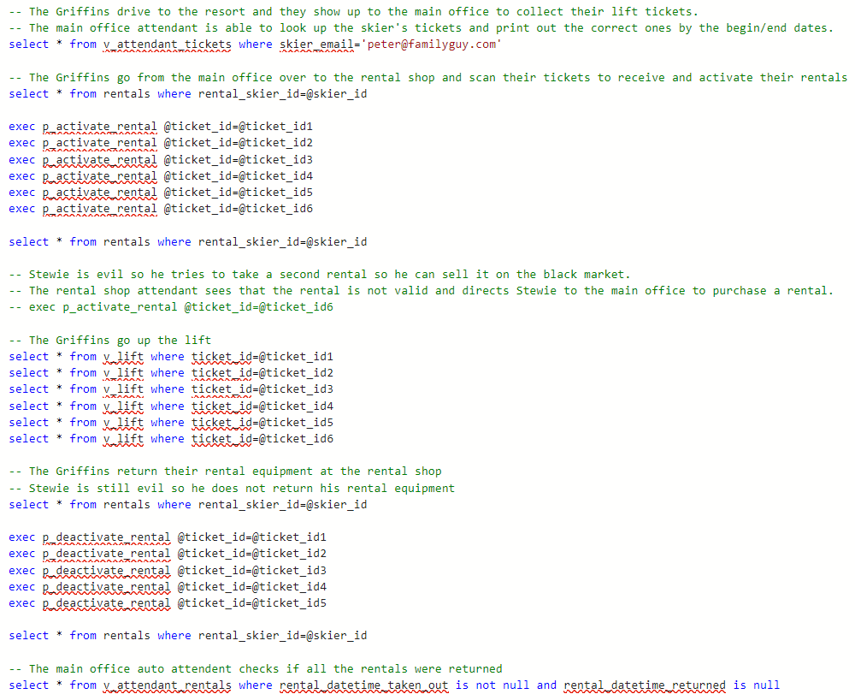
Implementation

Slide 23
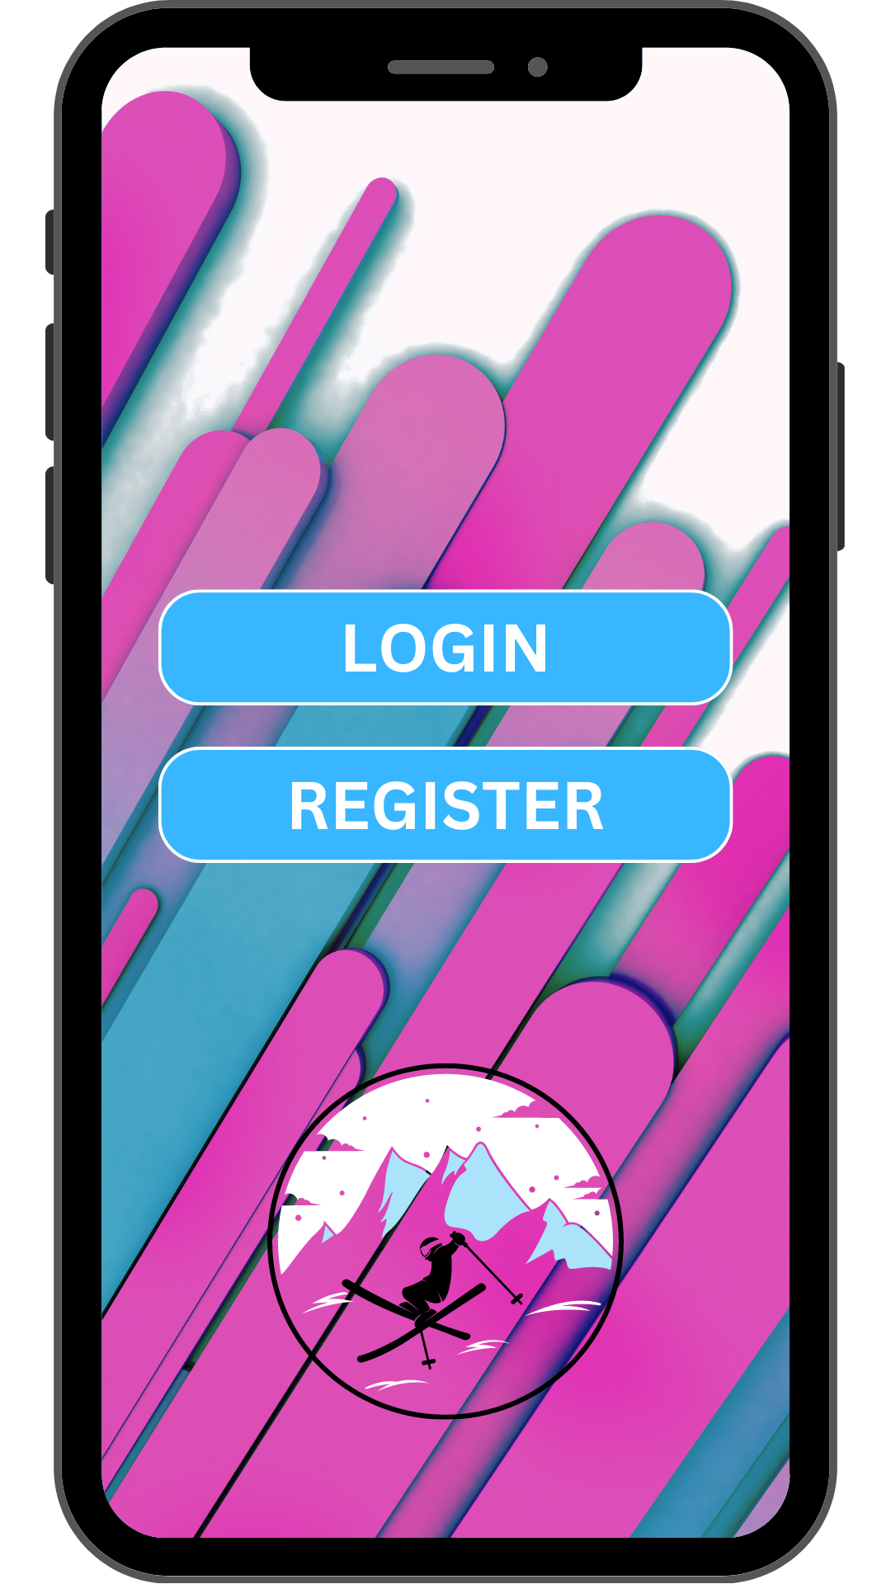
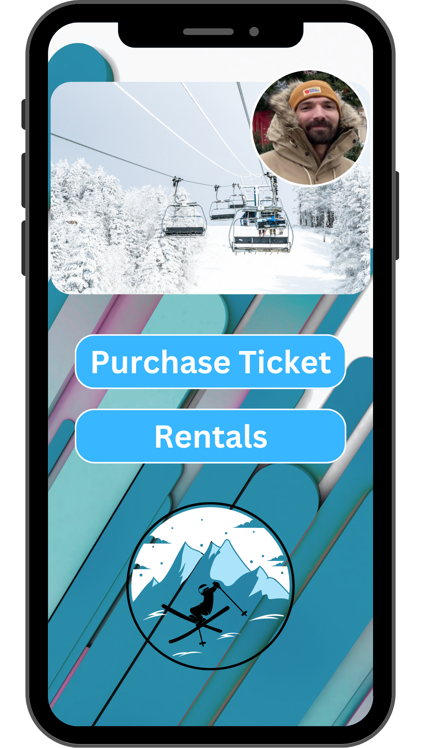
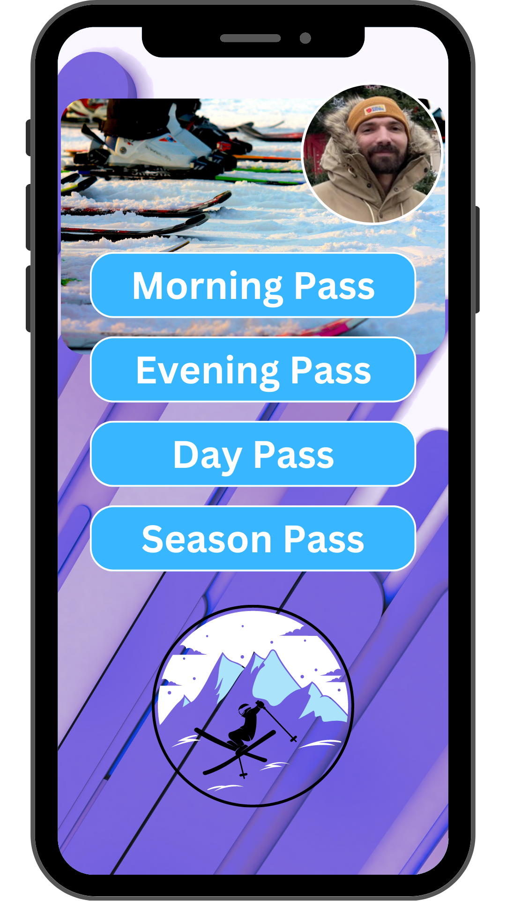
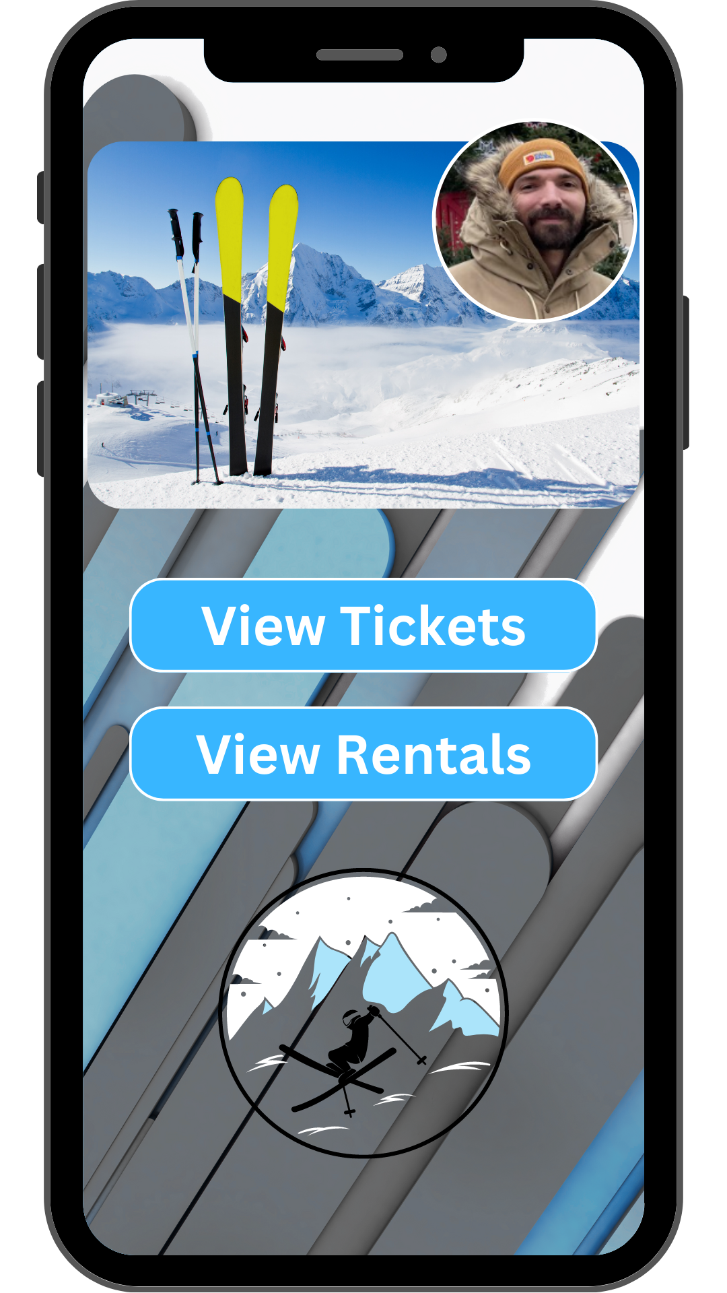

Slide 24
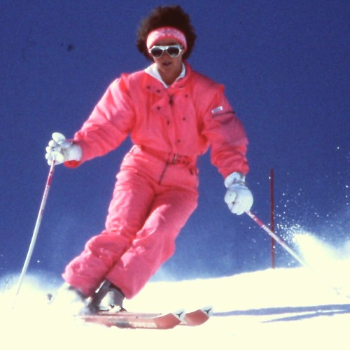
Thank You!
Team Megatron!

